Slide 1


Abhilasha Showroom “Your dreams, fulfilling them…is our aim…..”
Catalog as per user requirement.

Slide 2


Your preferences
Budget friendly.
Safety (The universal one ).
Compact SUV and Compact Sedan.

Slide 3
Our preferences
Give you the super best experience.
Make you feel that the car you purchased was made for you only.
We value your money, so will offer the best.

Slide 4
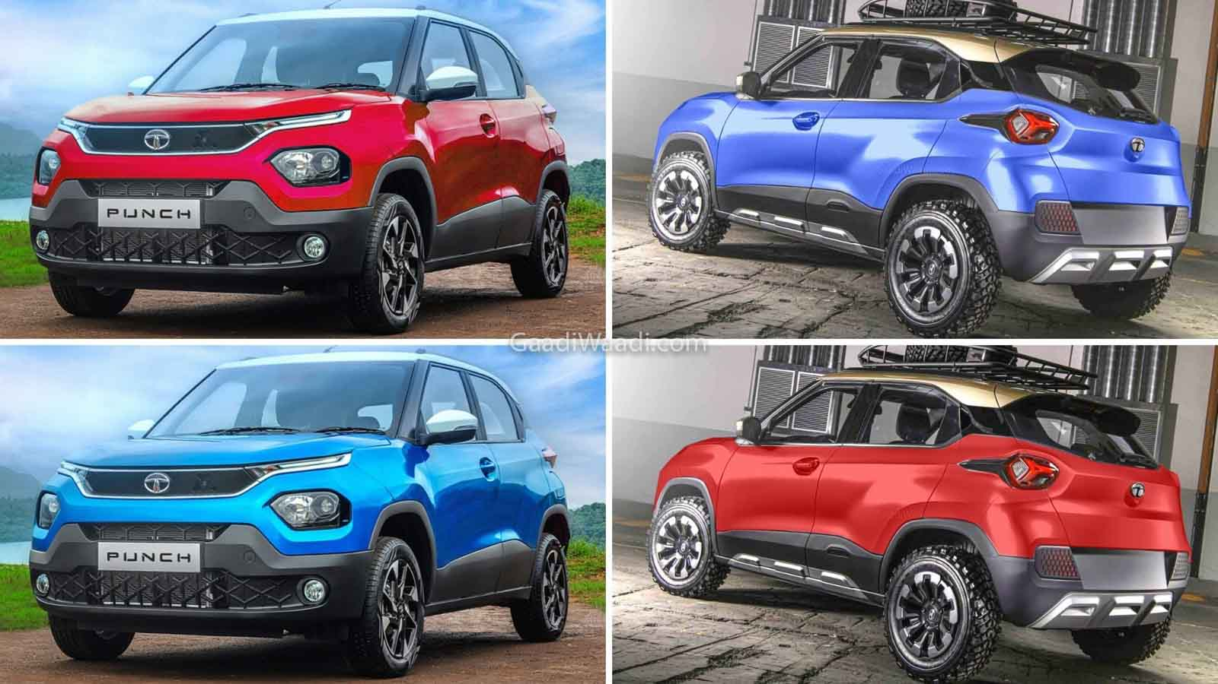
Compact SUV
TATA punch

Slide 5
This is your car if:
Budget and safety matter to you.
You want a car that gives you a smooth ride so that you can make memorable moments.

Slide 6
Features:
India’s safest car.
Very High On Safety Standards The Tata Punch is absolutely top-notch when it comes to safety standards. This is also justified by the Global NCAP results. The Tata Punch has achieved a 5-star safety rating for adult occupant protection and a 4-star safety rating for child occupant protection in Global NCAP's latest crash tests.
Good ground clearance.
Great car if you live in the city.
Provide smooth turn.
Back camera for parking.
Great legroom for heavy people.
Great customer feedback and statements.
All at just rupees ₹ 7,84,900 .

Slide 7
Features:
Airbags
Passenger Airbags
ABS
Electronic Brakeforce Distribution
Brake Sway Control (hilly area)
Anti glare IRVM
16" Diamond Cut Alloys
Comfort & Convenience
Air Conditioner - Auto
Steering Adjustment - Tilt
Power Outlets 12
Central Remote Locking With Flip Key
Follow-me-home headlamps
One-touch-down Door Window
Lights
Light Type - Halogen
Front Fog Lamps
LED Tail Lamps

Slide 8
Compact sedan
Honda Amaze
For safety - 2 airbags.
Ground clearance - 170 mm
Good build quality.
Only sedan to have Good quality global cut score. (4)
Good mileage especially on highway 15-17 km/pl.
Will give you the best driving experience because:
Has rev engine, Subtle ride quality.
Amazing engine torque.
You will never feel discomfort.
CVT(Continuously variable transmission …..variation in gears no specific limit)
No fatigue, best suited for the long drive.
Overall “A perfect mix of performance and mileage.”
Premium design.

Slide 9
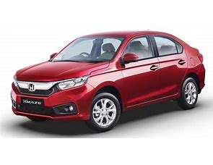
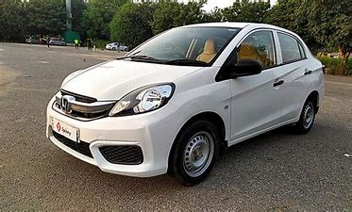
Model

